Slide 1
INDIAN SIGN LANGUAGE DETECTION USING MACHINE LEARNING
“Sign Language is the noblest gift God has given to deaf people.”
-George Veditz

Slide 2
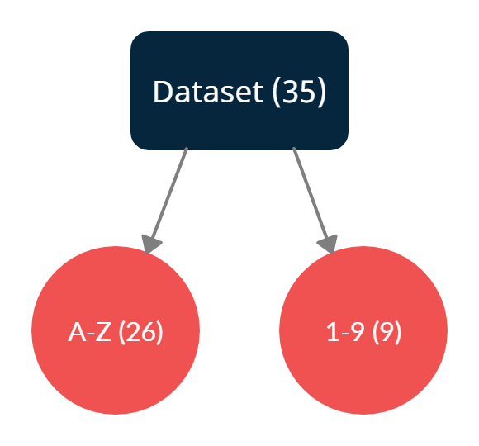
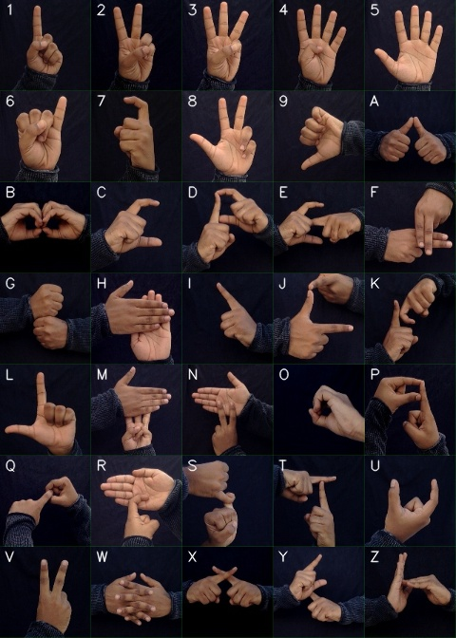
Dataset
Each of the alphabets and digits have 1200 images.
Total number of images in dataset = 1200X35 = 42000
Link to dataset:
https://drive.google.com/drive/folders/1keWr7X8aR4YMotY2m8SlEHlyruDDdVi

Slide 3
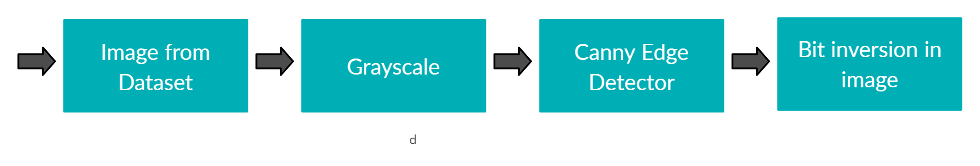
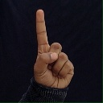
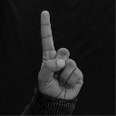
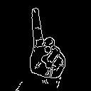
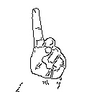
Preprocessing
Each image in the dataset is converted from RGB to Grayscale format.
The Canny Edge detector detects the edges of our hands therefore the shape of our hand acts as a parameter.
Then the image is bit inverted i.e white color spaces and black color spaces are exchanged.

Slide 4
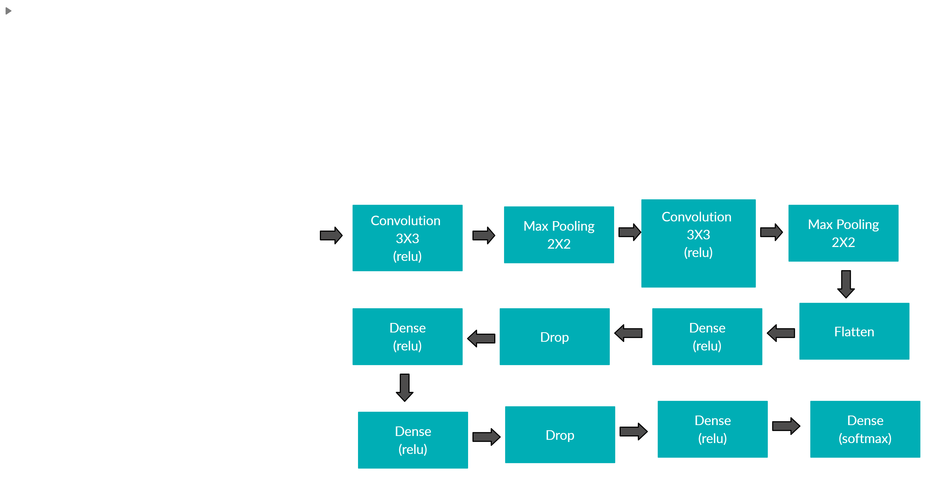
Convolutional Neural Network Model

Slide 5
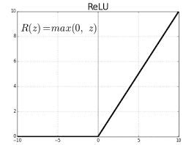
The image array is convolved with a 3X3 filter and then it is send to the Max pooling layer . This step is repeated twice.
The array is flattened. The dense layers are added to solve the complexities in our problem.
Four dense layers are used in our problem. Drop layer prevents our model from overfitting. Two drop layers are used.
Activation functions used:
1) ReLU (Rectified Linear Unit) :
The ReLU is the most used activation function in the world right now.
The ReLU is half rectified from bottom.
f(z) is zero when z is less than zero and f(z) is equal to z when z is above or equal to zero.

Slide 6
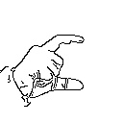
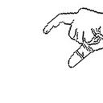
2) Softmax :
The softmax function is used as the activation function in the output layer of neural network models that predict a multinomial probability distribution.
That is, softmax is used as the activation function for multi-class classification problems where class membership is required on more than two class labels.
Data Augmentation :
As all images of our data were similar, we have used Data Augmentaion to create variation which further reduces chance of overfitting.
Various factors like rotation, width and height, shift ,scale, shear_range, zoom, flip can be changed to create a variation.
For example the below image is flipped and rotated.

Slide 7
Train-Test splits and Epochs
Train – 75% , Test – 25%.
Total training images -> 29673
Total test images -> 9906
Number of epochs = 14
Batch size = 10
Steps per epoch = 2625 (< No.of training images//Batch size)
Validation steps = 875.

Slide 8
Hunspell and Speech Recognizer
We formed words from the letters.
A python library named Hun spell was used . The word is sent to this function.
If the word makes sense the speech recognizer is called where we listen to the word and even store it as an .mp3 file else Hun spell suggests some alternative meaningful words.
For speech recognition we have used pyttsx3 library which converts text into speech.

Slide 9
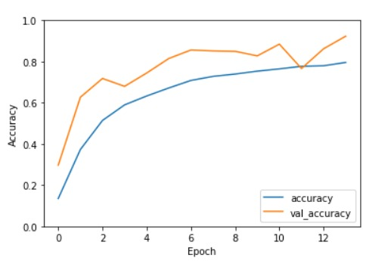
Graphs for Accuracy
The value of both training accuracy and validation accuracy increases logarithmically with the number of epochs.
We observe the peak values of accuracy at epoch = 14.

Slide 10
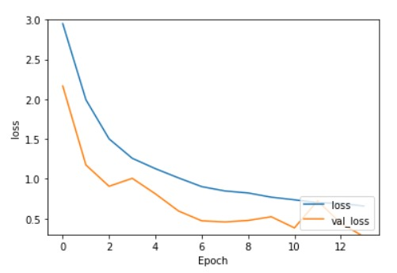
Graph for Loss
The value of both training loss and validation loss decreases exponentially with the number of epochs.
We observe the least value of loss at epoch = 14.

Slide 11
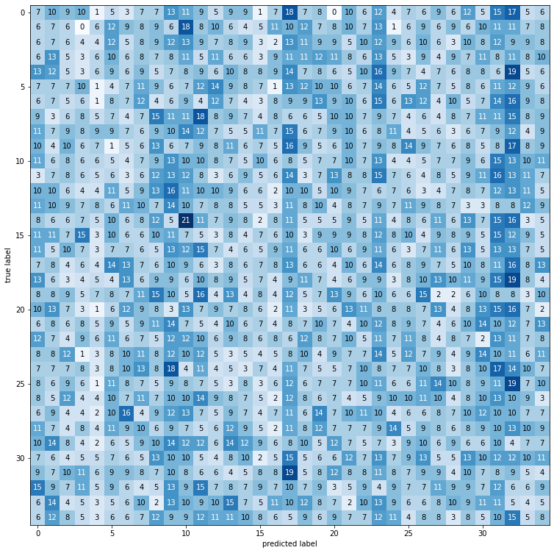
Confusion Matrix
Y-axis: True Label
X-axis: Predicted Label
Confusion Matrix size: (35,35)

Slide 12
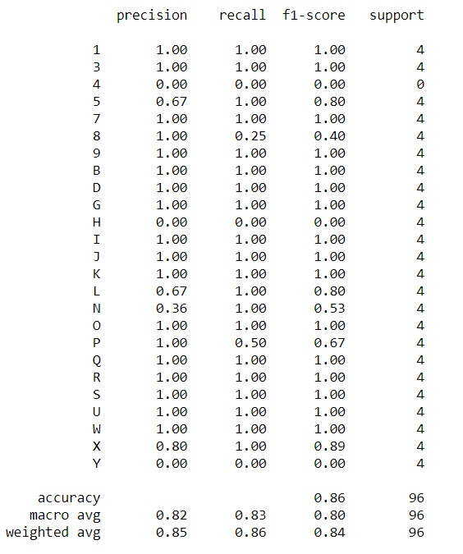



Classification Report

Slide 13
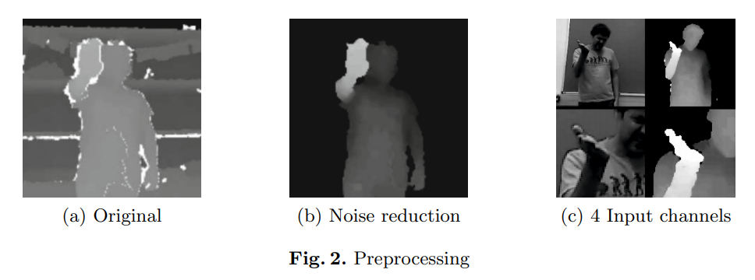
Base Paper
Link to base paper -> https://sci-hub.se/https://doi.org/10.1007/978-3-319-16178-5_40

Slide 14
Base Approach vs Our Approach
 | Base Approach | Our Approach
Training Accuracy | - | 94.30%
Testing Accuracy | 91.7% | 92.16%
No.of signs recognized | 20 | 35
Additional functionalities | - | Hun spell and Speech Recognition Systems
Preprocessing | thresholding, background removal using the user index, and median filtering | Canny edge Detector and Image bit inversion.

Slide 15
Future Scope
We would like to extend our model for predicting static gestures of Indian Sign Language.
The model could be extended to perform live testing of signs and gestures.
We would to like to work with a dataset which has images captured in lighting conditions.

Slide 16
THANK YOU
DONE BY:
Rohith Reddy Vangal (BT18CSE011)
Shashank Tudum (BT18CSE012)
Yashita Watchpillai (BT18CSE015)
Benhar Bandarupalli (BT18CSE017)
FACULTY ADVISOR:
Dr Nishath Ansari

